Slide 1
Principal component analysis
Bhuvaneshwari Patil

Slide 2
Variance and covariance
Variance and Covariance are a measure of the “spread” of a set of points around their center of mass (mean)
Variance – measure of the deviation from the mean for points in one dimension e.g. heights
Covariance as a measure of how much each of the dimensions vary from the mean with respect to each other.
Covariance is measured between 2 dimensions to see if there is a relationship between the 2 dimensions e.g. number of hours studied & marks obtained.
The covariance between one dimension and itself is the variance

Slide 3
Eigen value and Eigen vector
Eigen value gives the magnitude of the data
Eigen vector give the direction of spread of data
Intuitively, an eigenvector is a vector whose direction remains unchanged when a linear transformation is applied to it.

Slide 4
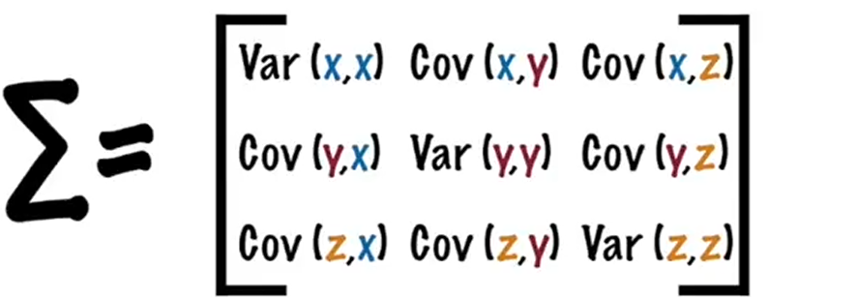

Covariance
2 | 3 | 5
4 | 3 | 6
4 | 5 | 7
If you had a 3-dimensional data set (x,y,z), then
you could measure the covariance between the x and y dimensions, the y and z dimensions, and the x and z dimensions.
Measuring the covariance between x and x , or y and y , or z and z would give you the variance of the x , y and z dimensions respectively.

Slide 5
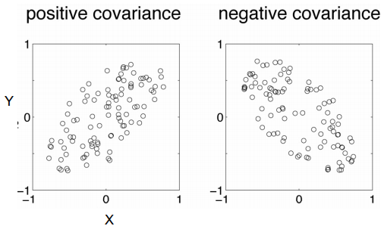
Covariance
Diagonal is the variances of x, y and z
cov(x,y) = cov(y,x) hence matrix is symmetrical about the diagonal
N-dimensional data will result in NxN covariance matrix

Slide 6
covariance
Exact value is not as important as it’s sign.
A positive value of covariance indicates both dimensions increase or decrease together e.g. as the number of hours studied increases, the marks in that subject increase.
A negative value indicates while one increases the other decreases, or vice-versa e.g. active social life at PSU vs performance in CS dept.
If covariance is zero: the two dimensions are independent of each other e.g. heights of students vs the marks obtained in a subject

Slide 7
covariance
Why bother with calculating covariance when we could just plot the 2 values to see their relationship?
Covariance calculations are used to find relationships between dimensions in high dimensional data sets (usually greater than 3) where visualization is difficult.

Slide 8
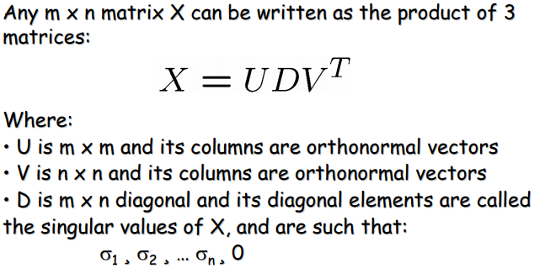
Singular Value Decomposition (SVD)

Slide 9
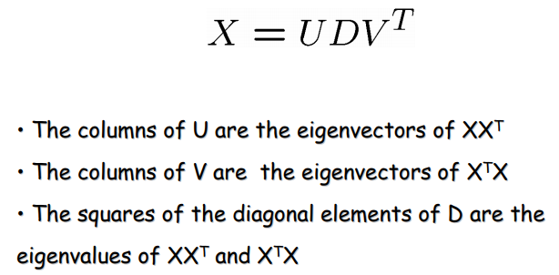
SVD Properties

Slide 10
Principal component analysis
principal components analysis (PCA) is a technique that can be used to simplify a dataset
It is a linear transformation that chooses a new coordinate system for the data set
greatest variance by any projection of the data set comes to lie on the first axis
The first principal component
the second greatest variance on the second axis, and so on.
PCA can be used for reducing dimensionality by eliminating the later principal components.

Slide 11

Dimension reduction

Slide 12
Steps involved
Take the whole dataset consisting of d+1 dimensions and ignore the labels such that our new dataset becomes d dimensional.
Compute the mean for every dimension of the whole dataset.
Compute the covariance matrix of the whole dataset.
Compute eigenvectors and the corresponding eigenvalues.
Sort the eigenvectors by decreasing eigenvalues and choose k eigenvectors with the largest eigenvalues to form a d × k dimensional matrix W.
Use this d × k eigenvector matrix to transform the samples onto the new subspace.

Slide 13
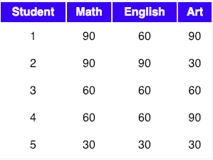

Numerical example
Let our data matrix X be the score of students:
Compute the mean of every dimension of the whole dataset.

Slide 14

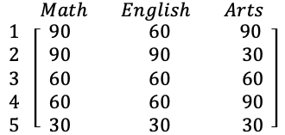
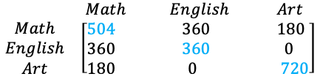
Nulerical example
Compute the covariance matrix of the whole dataset ( sometimes also called as the variance-covariance matrix)
Matrix A covariance of A

Slide 15
Cov(maths, maths)=cov(x,x)= )=(1/4)((90-66)(90-66)+(90-66)( 90-66)+(60-66)(60-66)+(60-66)(60-66)+(30-66)(30-66))
=504
Cov(maths,English)=cov(x,y)=(1/4)((90-66)(60-60)+(90-66)(60-90)+(60-66)(60-60)+(60-66)(60-60)+(30-66)(30-60))=360
Cov(English, arts)=cov(x,y)= )=(1/4)((60-60)(90-60)+(90-60)(30-90)+(60-60)(60-60)+(60-60)(90-60)+(30-60)(30-60))=180

Slide 16
Observations from covariance matrix
Shown in Blue along the diagonal, we see the variance of scores for each test.
The art test has the biggest variance (720)
the English test, the smallest (360).
i.e., art test scores have more variability than English test scores.
The covariance is displayed in black in the off-diagonal elements of the matrix A
The covariance between math and English is positive (360)
the covariance between math and art is positive (180).
This means the scores tend to covary in a positive way.
scores on math go up, scores on art and English also tend to go up; and vice versa.
The covariance between English and art is zero.
This means there tends to be no predictable relationship between the movement of English and art scores.

Slide 17




Compute Eigen vectors and corresponding Eigen values
Let A be a square matrix, ν a vector and λ a scalar that satisfies Aν = λν, then λ is called eigenvalue associated with eigenvector ν of A.
The eigenvalues of A are roots of the characteristic equation
Av-lab. V=0
A[V1,v2,v3]T
=

Slide 18

Solve for eigen value
Equate to zero
After solving, we get the values as
Link for calculating eigen value https://study.com/academy/lesson/eigenvalues-eigenvectors-definition-equation-examples.html

Slide 19


Eigen vector
Eigen vectors for corresponding eigen values
Sort the eigenvectors by decreasing eigen values
choose k eigenvectors with the largest eigen values to form a d × k dimensional matrix W.
= 0

Slide 20
Principal axis
projecting the feature space via PCA onto a smaller subspace,
where the eigenvectors will form the axes of this new feature subspace.
However, the eigenvectors only define the directions of the new axis,
they have all the same unit length 1.
the eigenvectors with the lowest eigenvalues bear the least information about the distribution of the data
those are the ones we want to drop.

Slide 21

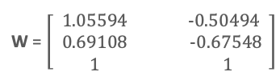
Principal axis
Sort the Eigen values in decreasing order
we are reducing a 3-dimensional feature space to a 2-dimensional feature subspace, we are combining the two eigenvectors with the highest eigen values to construct our d×k dimensional eigenvector matrix W.

Slide 22
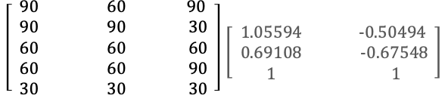
transformation
Transform the samples onto the new subspace
In the last step, we use the 2×3 dimensional matrix W that we just computed to transform our samples onto the new subspace via the equation y = W′ × x where W′ is the transpose of the matrix W.

